Slide 1
COMP10001
Week 5

Slide 2
Methods, iteration and loops

Slide 3
What is a method? How are methods different/similar to functions?

Slide 4
What is a method? How are methods different/similar to functions?
Like functions, methods run some pre-defined code to achieve a task
Both are called with brackets, containing arguments
Methods are “attached” to an object with a full stop:
function_name(arguments, …) vs object.method_name(arguments, …)
So methods can do fun things like edit the object they’re called on in-place!

Slide 5
Let’s do an exercise!
Let s="Computing is FUN!". What happens when we apply the methods below?
s.isupper()
s.count(“n”)
s.upper()
s.strip(“!”)
s.endswith(“fun!”)
s.replace(“i”, “!”)

Slide 6
Let’s do an exercise!
Let s="Computing is FUN!". What happens when we apply the methods below?
s.isupper()
s.count(“n”)
False
2
s.upper()
s.strip(“!”)
“COMPUTING IS FUN!”
“Computing is FUN”
s.endswith(“fun!”)
s.replace(“i”, “!”)
True
“Comput!ng !s FUN!”

Slide 7
What is the difference between a list and a tuple?

Slide 8
What is the difference between a list and a tuple?
Lists are mutable
Tuples are not!

Slide 9
What is the difference between a list and a tuple?
Lists are mutable
Tuples are not!
We can make changes to mutable items “in-place”
E.g. lst += [3]

Slide 10
What is the difference between a list and a tuple?
Lists are mutable
Tuples are not!
We can make changes to mutable items “in-place”
E.g. lst += [3]
Lists initialised with square brackets
E.g. lst = [1,2,3]
Tuples initialised with rounds brackets
E.g. tup = (1,)
Or the tuple() function!

Slide 11
How do we add and remove items from a list?

Slide 12
How do we add and remove items from a list?
.append(item),
.insert(index, item),
.extend(lst)
.pop(index)
del
.remove(item)
.clear()

Slide 13
Let’s do an exercise!
Let lst=[2, ("green", “eggs”, “ham”), False]. What happens when we use the expressions below?
lst[2]
lst.append(5); print(lst)
lst[1][-2]
lst.pop(2); print(lst)
lst[1][-2][:3]
lst.reverse(); print(lst)

Slide 14
Let’s do an exercise!
Let lst=[2, ("green", “eggs”, “ham”), False]. What happens when we use the expressions below?
lst[2]
lst.append(5); print(lst)
False
[2, ("green", “eggs”, “ham”), False, 5]
lst[1][-2]
lst.pop(2); print(lst)
“eggs”
False
[2, ("green", “eggs”, “ham”)]
lst[1][-2][:3]
lst.reverse(); print(lst)
True
[False, ("green", “eggs”, “ham”), 2]

Slide 15
What is “iteration” in programming? Why do we need it?

Slide 16
What is “iteration” in programming? Why do we need it?
Iteration = executing a section of code repeatedly
often with a small change each time

Slide 17
What is “iteration” in programming? Why do we need it?
Iteration = executing a section of code repeatedly
often with a small change each time
We need to do this all the time in programming!
Writing the same instructions over and over again is inefficient! Unreadable! Error-prone!

Slide 18
What are the two types of loop in Python? How do we structure them?
Notes:
Emph loop variable

Slide 19
What are the two types of loop in Python? How do we structure them?
For loops
For <loop variable> in <sequence>:
Do something with the loop variable
…
Notes:
Emph loop variable

Slide 20
What are the two types of loop in Python? How do we structure them?
For loops
For <loop variable> in <sequence>:
Do something with the loop variable
…
While loops
While <condition>:
Do something
…
Notes:
Emph loop variable

Slide 21
How are the two types of loops different?
When should we use one over the other?

Slide 22
How are the two types of loops different?
When should we use one over the other?
For loop iterates over a sequence:
finite/controlled number of iterations

Slide 23
How are the two types of loops different?
When should we use one over the other?
For loop iterates over a sequence:
finite/controlled number of iterations
While loop iterates until truth of condition changes:
infinite/uncontrolled number of iterations

Slide 24
How are the two types of loops different?
When should we use one over the other?
For loop iterates over a sequence:
finite/controlled number of iterations
While loop iterates until truth of condition changes:
infinite/uncontrolled number of iterations
For loops are great when we know in advance how many times we need our loop to run
While loops are great when we don’t know!

Slide 25
Can we always convert a for into a while and vice versa?

Slide 26
Can we always convert a for into a while and vice versa?
For can always be converted into a while
Converting a while into a for is not always possible!

Slide 27
Can we always convert a for into a while and vice versa?
For can always be converted into a while
Converting a while into a for is not always possible!
To convert a loop, identify:

Slide 28
Can we always convert a for into a while and vice versa?
For can always be converted into a while
Converting a while into a for is not always possible!
To convert a loop, identify:
What the loop variable is initialised to

Slide 29
Can we always convert a for into a while and vice versa?
For can always be converted into a while
Converting a while into a for is not always possible!
To convert a loop, identify:
What the loop variable is initialised to
How the loop variable is incremented/changed during each iteration

Slide 30
Can we always convert a for into a while and vice versa?
For can always be converted into a while
Converting a while into a for is not always possible!
To convert a loop, identify:
What the loop variable is initialised to
How the loop variable is incremented/changed during each iteration
When the loop should terminate

Slide 31
Can we always convert a for into a while and vice versa?
For can always be converted into a while
Converting a while into a for is not always possible!
To convert a loop, identify:
What the loop variable is initialised to
How the loop variable is incremented/changed during each iteration
When the loop should terminate
lst = [“a”,”b”,”c”]
for letter in lst:
print(letter + “!”)

Slide 32
Can we always convert a for into a while and vice versa?
For can always be converted into a while
Converting a while into a for is not always possible!
To convert a loop, identify:
What the loop variable is initialised to
How the loop variable is incremented/changed during each iteration
When the loop should terminate
i = 1
j = 1
while i < 5:
print(i, j, i + j)
hold = i
i = i + j
j = hold
lst = [“a”,”b”,”c”]
for letter in lst:
print(letter + “!”)

Slide 33
Can we always convert a for into a while and vice versa?
For can always be converted into a while
Converting a while into a for is not always possible!
To convert a loop, identify:
What the loop variable is initialised to
How the loop variable is incremented/changed during each iteration
When the loop should terminate
i = 1
j = 1
while i < 5:
print(i, j, i + j)
hold = i
i = i + j
j = hold
i | j | i + j
lst = [“a”,”b”,”c”]
for letter in lst:
print(letter + “!”)

Slide 34
Can we always convert a for into a while and vice versa?
For can always be converted into a while
Converting a while into a for is not always possible!
To convert a loop, identify:
What the loop variable is initialised to
How the loop variable is incremented/changed during each iteration
When the loop should terminate
i = 1
j = 1
while i < 5:
print(i, j, i + j)
hold = i
i = i + j
j = hold
i | j | i + j
1 | 1 | 2
lst = [“a”,”b”,”c”]
for letter in lst:
print(letter + “!”)

Slide 35
Can we always convert a for into a while and vice versa?
For can always be converted into a while
Converting a while into a for is not always possible!
To convert a loop, identify:
What the loop variable is initialised to
How the loop variable is incremented/changed during each iteration
When the loop should terminate
i = 1
j = 1
while i < 5:
print(i, j, i + j)
hold = i
i = i + j
j = hold
i | j | i + j
1 | 1 | 2
2 | 1 | 3
lst = [“a”,”b”,”c”]
for letter in lst:
print(letter + “!”)

Slide 36
Can we always convert a for into a while and vice versa?
For can always be converted into a while
Converting a while into a for is not always possible!
To convert a loop, identify:
What the loop variable is initialised to
How the loop variable is incremented/changed during each iteration
When the loop should terminate
i = 1
j = 1
while i < 5:
print(i, j, i + j)
hold = i
i = i + j
j = hold
i | j | i + j
1 | 1 | 2
2 | 1 | 3
3 | 2 | 5
lst = [“a”,”b”,”c”]
for letter in lst:
print(letter + “!”)

Slide 37
Exercises!

Slide 38
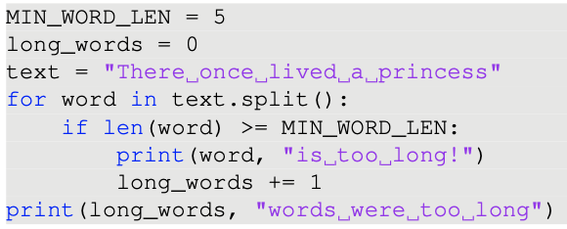
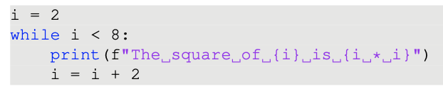
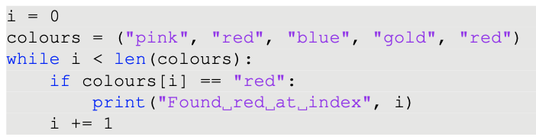
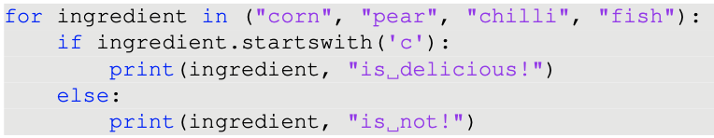
What is the output of the following snippets?

Slide 39
Rewrite the snippets with an alternative loop command!

Slide 40
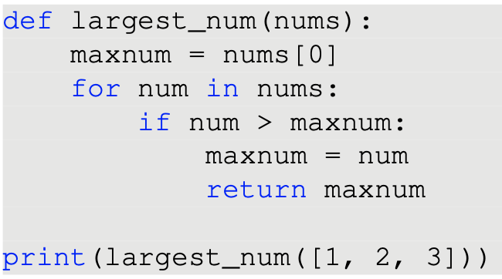
What’s wrong with this code? How should we fix it?

Slide 41
Let’s jump in breakout rooms for Ex. 3

Slide 42

Ex. 3 solutions

Slide 43

Ex. 3 solutions

Slide 44
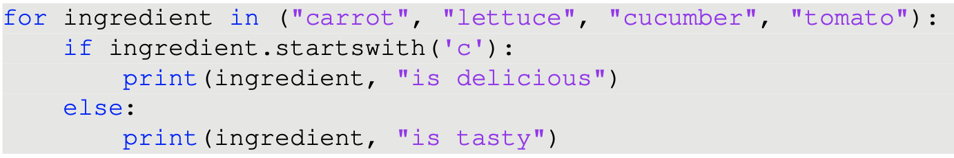
Ex. 3 solutions

Slide 45
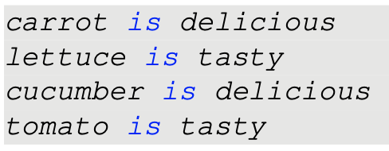
Ex. 3 solutions

Slide 46
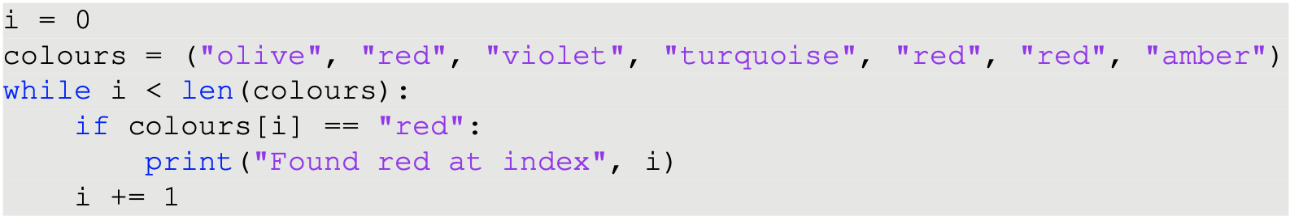
Ex. 3 solutions

Slide 47
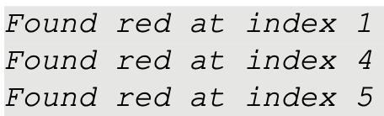
Ex. 3 solutions

Slide 48
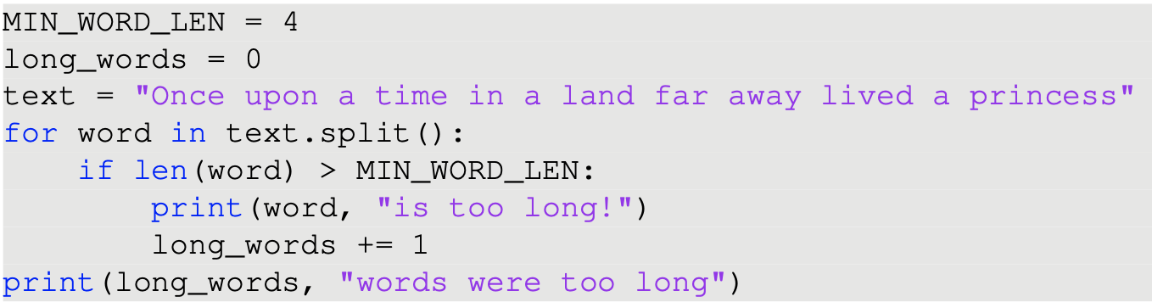
Ex. 3 solutions

Slide 49
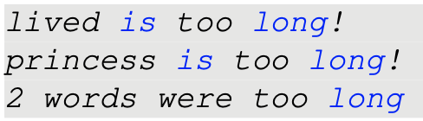
Ex. 3 solutions

Slide 50
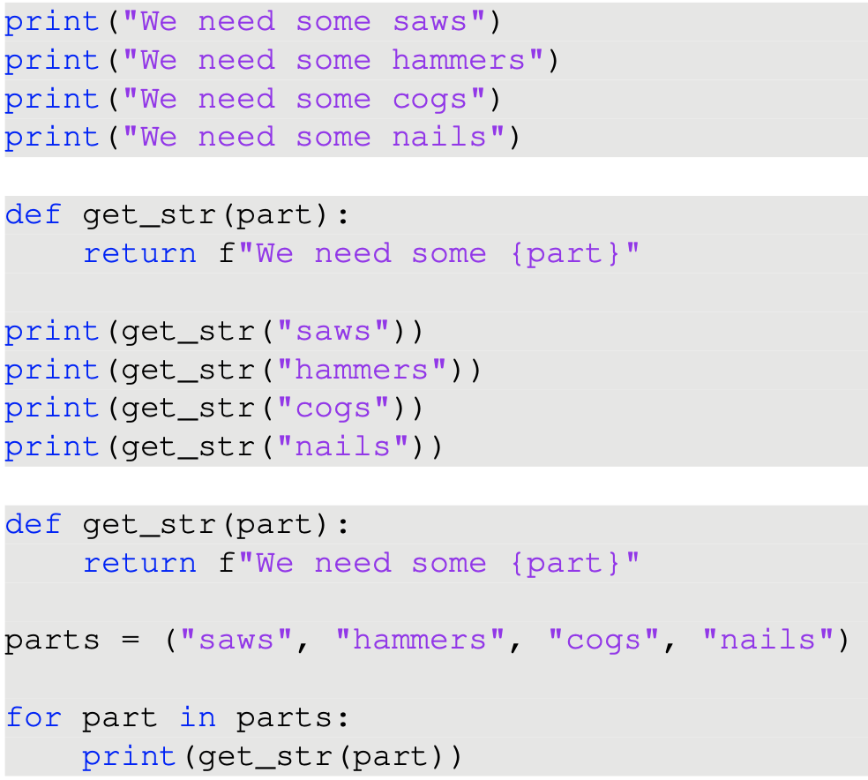
Last exercise for today!
Do the following snippets do the same thing?
What are their advantages/disadvantages?

Slide 51
Coding problems
Write a function which takes an integer input n and prints the thirteen times tables from 1 * 13 until n * 13.
Write a function which takes a tuple of strings and returns a list containing only the strings which contain at least one exclamation mark or asterisk symbol.

Slide 52
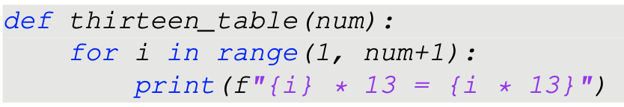
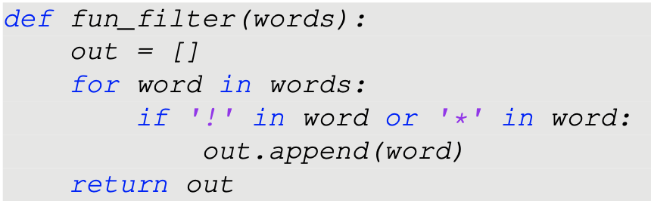
Coding problems
Write a function which takes an integer input n and prints the thirteen times tables from 1 * 13 until n * 13.
Write a function which takes a tuple of strings and returns a list containing only the strings which contain at least one exclamation mark or asterisk symbol.

